Slide 1
Chapter 5
Measuring observations

Slide 2
Measurement
Measurement – Careful, deliberate observations of the real world
  Purpose: Describing objects and events in terms of the attributes composing the variable.
  Needs to be purposeful/deliberate! Pick your measurements w/ care!

Slide 3
Measuring Observations
Important to carefully decide how you’ll measure a variable of interest
Before you can measure, need to define what concept your variable represents

Slide 4
Conceptualization
How would you define…
  Extraversion?
  Anxiety?
  Aggression?

Slide 5
Conceptualization
Conceptualization – Specifying what we mean when we use particular terms in research.
Cannot meaningfully answer a question without a working agreement about the meaning of the outcome!
Leads to a specific agreed-on meaning for a concept for the purposes of research.

Slide 6
Conceptualization
Indicators and Dimensions
  Indicator – An observation that we choose to consider as a reflection of a variable we wish to study.
    Example: Indicators of happiness
  Dimension – A specifiable aspect of a concept. Could a concept have many dimensions?
    Example: What dimensions make up personality?

Slide 7
Dimensions Example
Trait: Extraversion
  Possible Dimensions:
    Outgoing
    Leadership
    Assertiveness

Slide 8
Dimensions Example
Trait: Agreeableness
  Possible Dimensions???

Slide 9
Conceptualization
Indicators and Dimensions
  Indicator == What we pick to reflect our concept
  Dimension == What aspects of the concept we think are important to measure

Slide 10
Defining Concepts
Operational Definition:
  How a concept will be measured – that is, the operations we will perform.
  Also called operationalizing a concept or variable

Slide 11
Descriptive Research
Definitions are more problematic for descriptive research than for explanatory research.
  A single concept can be operationalized in several ways!
Important to:
  1) Be consistent w/ definition
  2) Check whether definition aligns with other researchers

Slide 12
Variables vs Attributes
An attribute is a characteristic or quality of something/someone (ex: female, old, student).
A variable is a set of attributes (ex: gender, age).
  Needs at least two attributes to be a variable!
Every variable must have two important qualities:
  The attributes composing it should be exhaustive.
  Attributes must be mutually exclusive.

Slide 13
Operationalization Choices
Levels of Measurement (scales of measurement)
  Nominal
  Ordinal
  Interval
  Ratio

Slide 14
Operationalization Choices
Nominal Data
  Variables have only the characteristics of exhaustiveness and mutually exclusiveness.
    Don’t actually measure anything, just categories!
  Examples: gender, religious affiliation, college major, hair color, birthplace, nationality
  Think labels!

Slide 15
Operationalization Choices
Ordinal Data
  Can be logically ranked.
  Examples: socioeconomic status, level of conflict, prejudice, conservativeness, hardness
  Organized by size/magnitude
  No meaningful distance between observations

Slide 16
Operationalization Choices
Interval Data
  Variables for which the actual distance between attributes has meaning.
  Examples: temperature (Fahrenheit), IQ score
  Arbitrary zero!
    0 degrees F = very cold, not absence of temperature!
  Meaningful Distance
    80 degrees F is twice as warm as 40 degrees F

Slide 17
Operationalization Choice
Ratio Data
  Variables whose attributes meet the requirements of an interval measure, and has a true zero point.
  Examples: temperature (Kelvin), age, length of time, number of organizations, number of groups, number of A’s received in college
  Zero == absence of variable!

Slide 18
Scales of Measurement
Scale | Characteristics | Examples
Nominal | Label and categorize No quantitative distinctions | Sex Diagnosis Experimental or Control
Ordinal | Categorizes observations Categories organized by size or magnitude | Rank in class Clothing sizes (S,M,L,XL) Olympic medals
Interval | Ordered categories Interval between categories of equal size Arbitrary or absent zero point | Temperature IQ
Ratio | Ordered categories Equal interval between categories Absolute zero point | Number of correct answers Time to complete task Gain in height since last year

Slide 19
Reliability
Reliability: Does this method consistently measure what is being studied?
  Research is only as good as the measurement used
    Garbage in, garbage out…
  Example: Two rulers should also measure an inch the same way
  Psych Example: A reliable IQ test should show“identical” scores when given twice over a two-week interval

Slide 20
Precision vs. Reliability
Precision
  Precise measures are superior to imprecise ones.
  Precision is not the same as accuracy.
Reliability
  Would multiple uses of a measure return the same general pattern?
  Reliability is not the same as accuracy!

Slide 21
Measuring Reliability
  Test-Retest Method
    To take the same measurement more than once.
    A reliable test should yield the same results if the same person takes it multiple times!
  Test Re-test Reliability
    Important! Especially for longitudinal studies!

Slide 22
Validity
Validity: Does this accurately measure the variable of interest?
  Example: Does a personality test truly measure extraversion? Or something related like Assertiveness?

Slide 23
Criteria of Measurement Quality
Validity – a term describing a measure that accurately reflects the concept it is intended to measure.
  Face Validity – That quality of an indicator that makes it seem a reasonable measure of some variable.
  Example: If a measure that is supposed to measure happiness looks like it measures happiness, then it has high face-validity

Slide 24
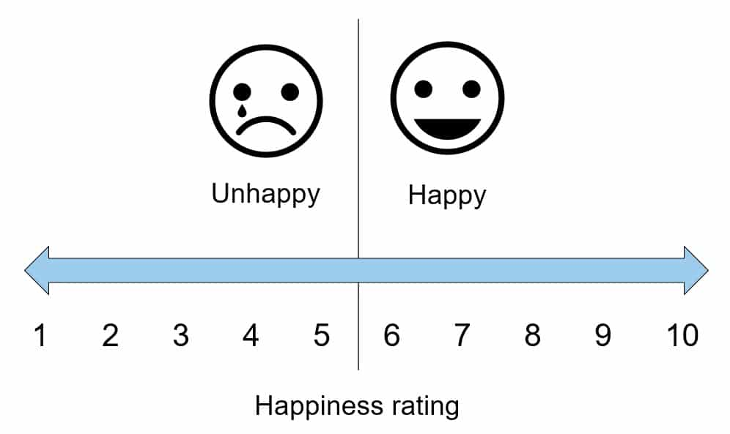
Measuring happiness?

Slide 25
Measuring sadness?

Slide 26
Measuring anxiety?

Slide 27
Measuring age?

Slide 28
Criteria of Measurement Quality
  Construct Validity – The degree to which a measure relates to other variables as expected within a system of theoretical relationships.
  Content Validity – The degree to which a measure covers the range of meanings included within a concept.

Slide 29
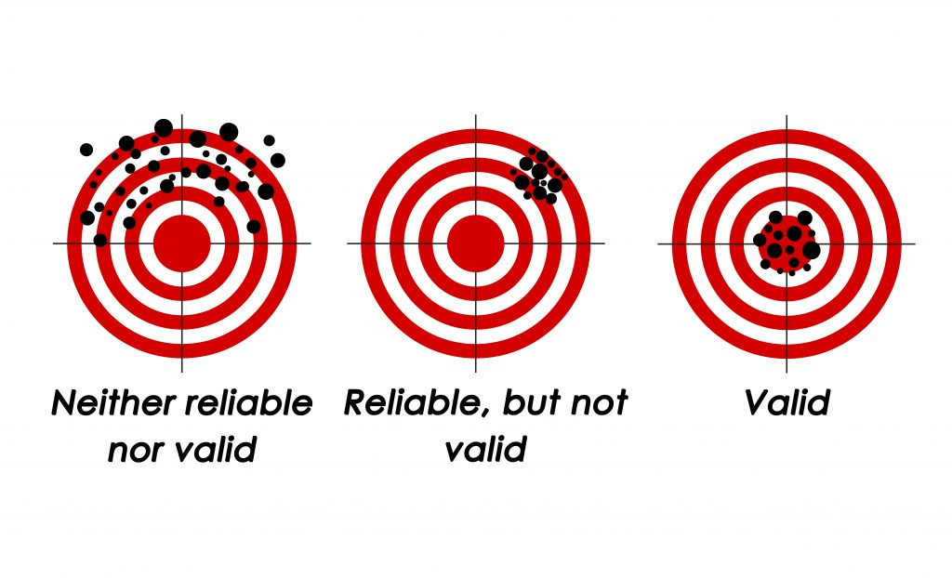

Slide 30
The Ethics of Measurement
Conceptualization and measurement must not be guided by bias or preferences for particular research outcomes
Don’t want to influence the results!

